Slide 1
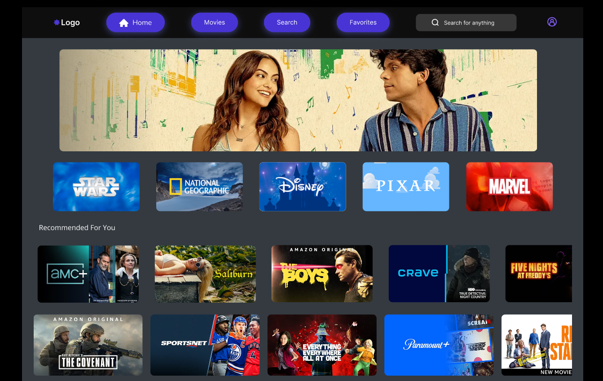
Presentation on Movie Streaming Website
Presented by-
Zheengyuan Liu
Partha Sinha
Ning Lu
CST 8318- 013- Group #2
Apr – 11- 2024

Slide 2
Introduction
We have developed this movie streaming platform inspired by popular services like Netflix, Disney, and Amazon Prime Video, as we are using some kinds of streaming services almost every day to enjoy movies.
These services are also very convenient to use from home or on the go, as long as we have internet.
Our goal is to cater to a diverse audience of all age groups. Users will have the ability to personalize their experience by setting preferences.
This customization ensures that users can discover and enjoy content tailored to their tastes and interests.

Slide 3
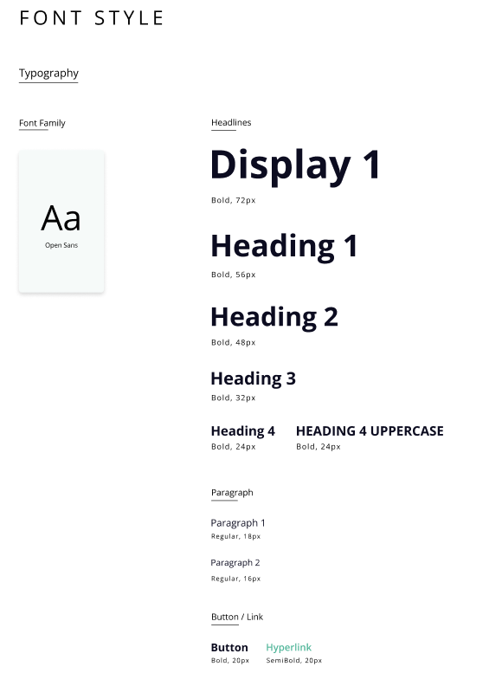
Design System
We used Open Sans as the Font Family, which is a humanist sans-serif typeface known for its legibility and clean appearance.
Display 1: The largest headline, is set in bold at 72 pixels.
Heading 1: A slightly smaller size at 56 pixels, also bold.
Paragraph 1: This is the standard paragraph text, set at 18 pixels in regular weight. It's the text used for the bulk of the content where readability is crucial.
Button: Text for buttons is bold and set at 20 pixels, making it stand out and easily clickable.

Slide 4
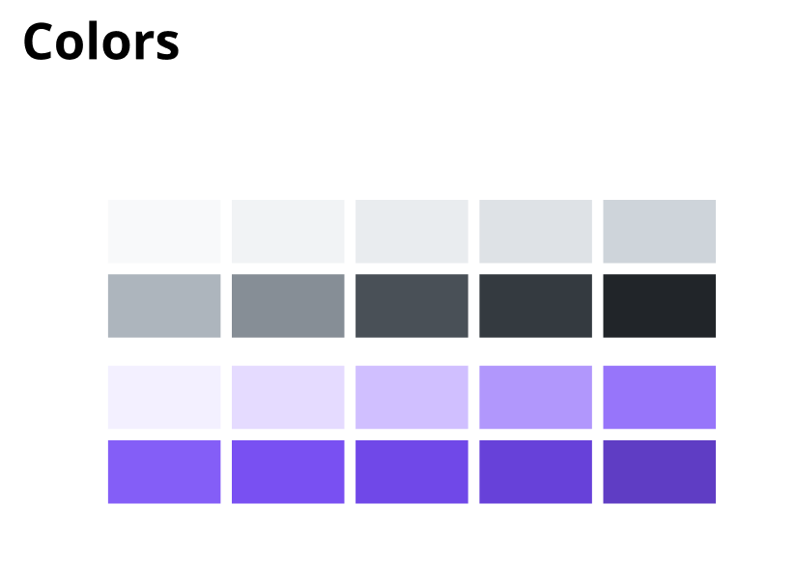
Design System
Grayscale Colors:
The top row contains a range of grays from very light to very dark.
We used dark grey for background and lighter grey for text. In some cases, we used black as a text and light grey as a background to continue of the color contrast.
Violet Colors:
The bottom row features a gradient of violet from very light lavender to deep purple.
We used darker violet for buttons. For hover on these buttons, we used lighter violet to draw attention.
The darkest purple could serve as an accent color for important interactive elements or to draw the eye to areas of importance, like primary calls to action.
The use of a consistent set of colors ensures the interface is cohesive and that users can quickly learn what each color signifies within the context of the website.

Slide 5
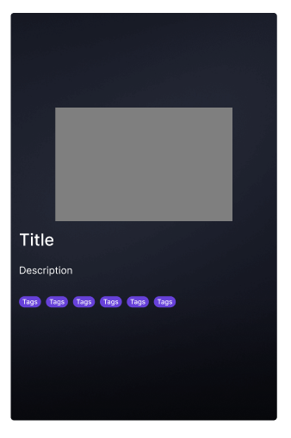
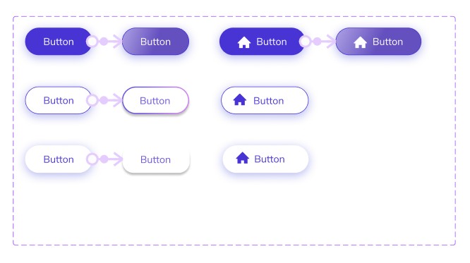
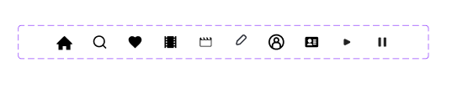
Design System
Card
Icons
Buttons

Slide 6
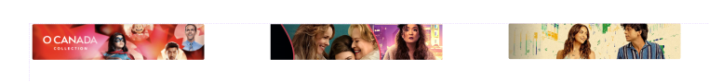

Design System
Top Navigation
Banner
Hover
Footer

Slide 7
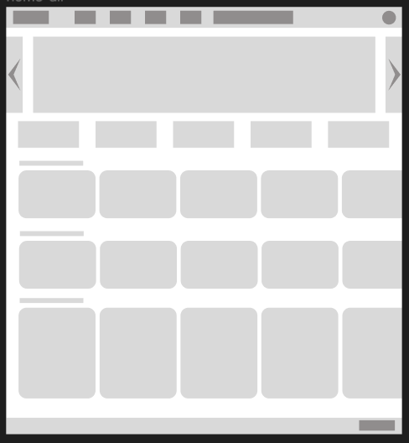
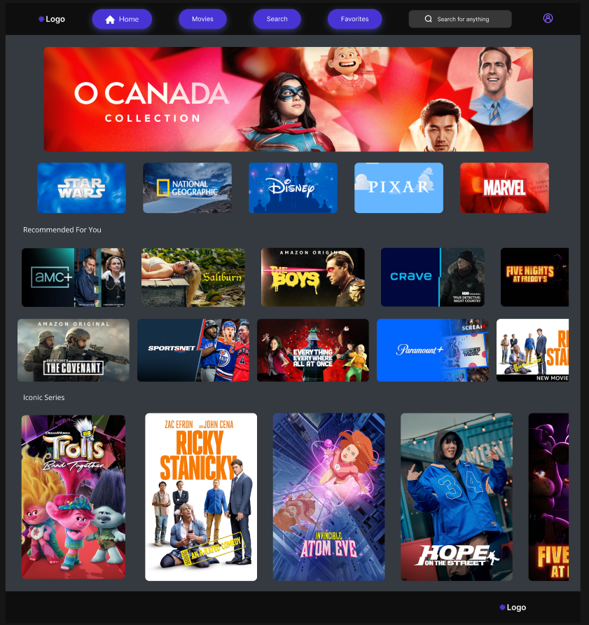
Screen Comparison- Home Page

Slide 8
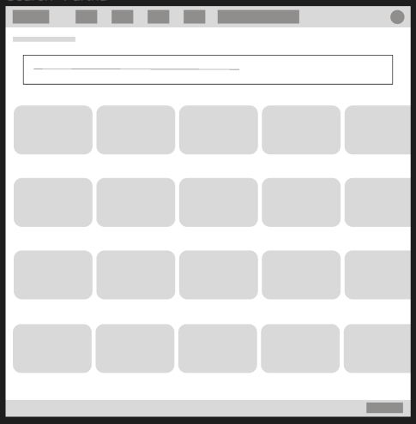
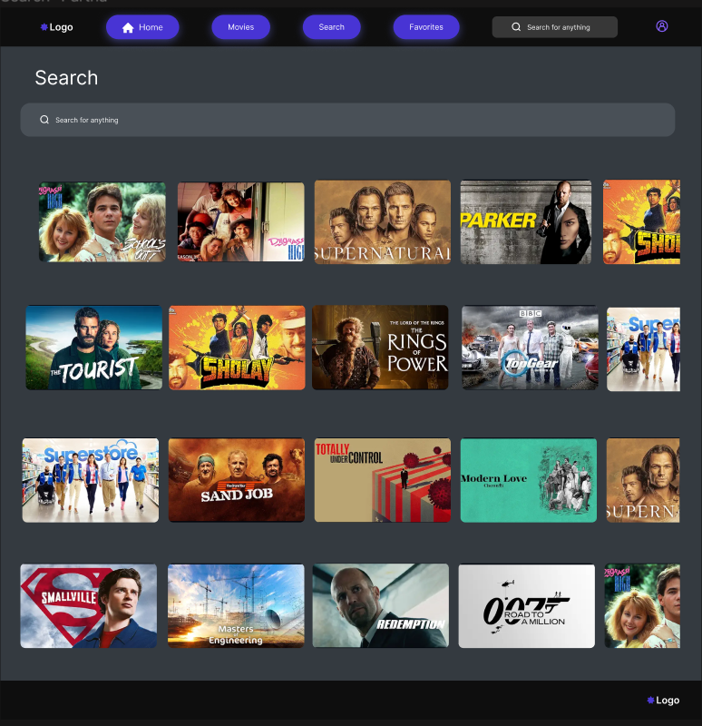
Screen Comparison- Search Page

Slide 9
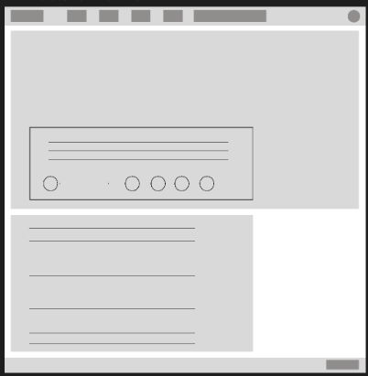
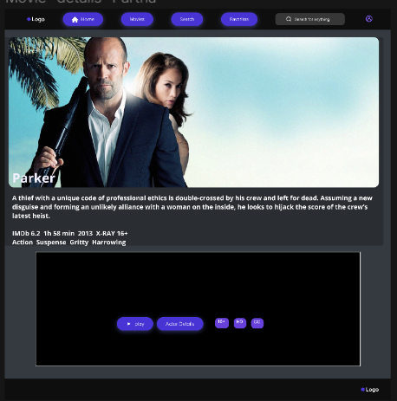
Screen Comparison- Movie Details

Slide 10
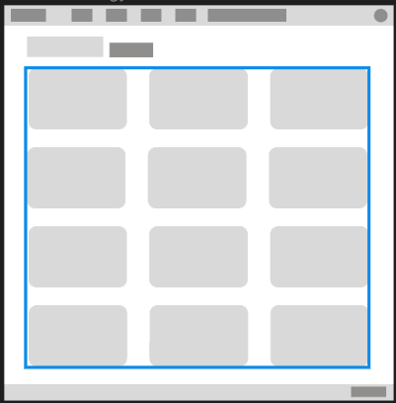
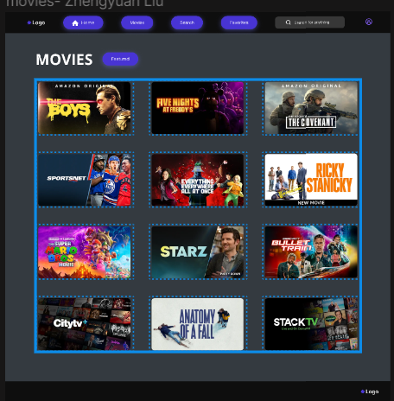
Screen Comparison- Movies

Slide 11

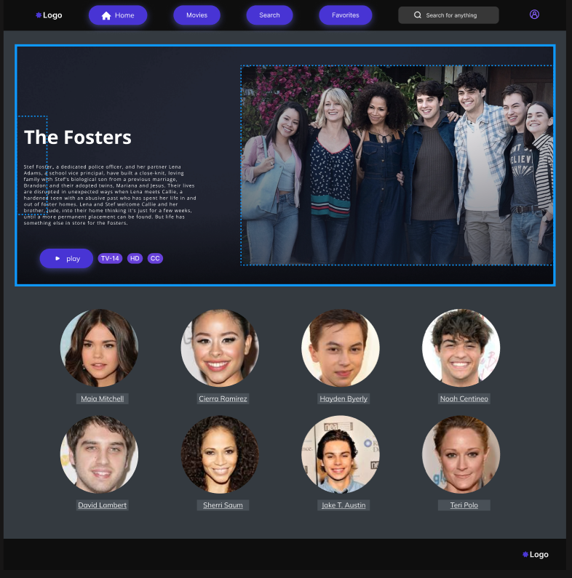
Screen Comparison- Actor Details

Slide 12

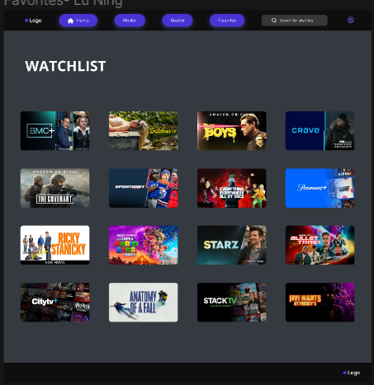
Screen Comparison- Favorites

Slide 13

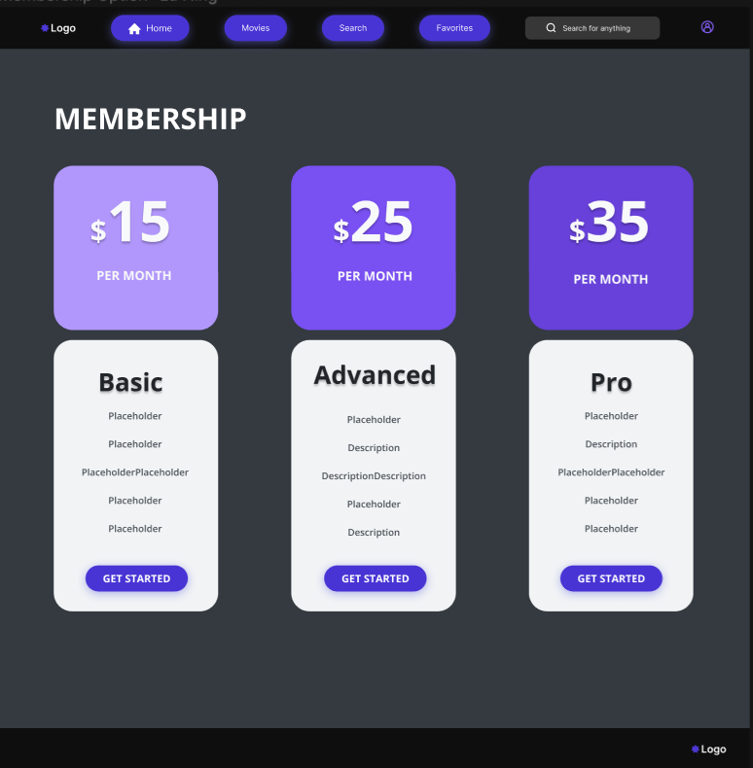
Screen Comparison- Subscription Page

Slide 14
Demo
Theme: Movie Streaming Website
Team Member:
Partha Sinha
Zhengyuan Liu
Ning Lu.

Slide 15
Thank You!

